Slide 1


Введение в F# на примере разработки телеграм бота
Николай Матюшин

Slide 2

Зачем?

Slide 3
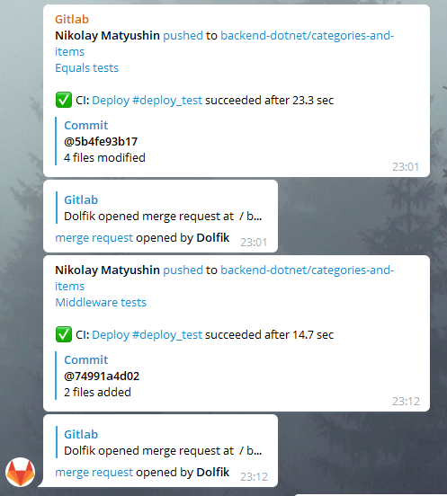
Зачем?

Slide 4
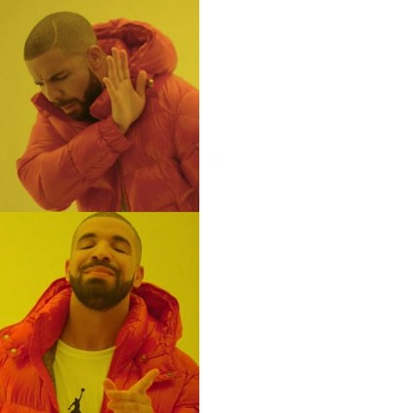
Зачем?
ООП
ФП

Slide 5

Функциональное программирование

Slide 6

Функциональное программирование

Slide 7

Функциональное программирование

Slide 8










Функциональные языки

Slide 9
Почему F#?

Slide 10
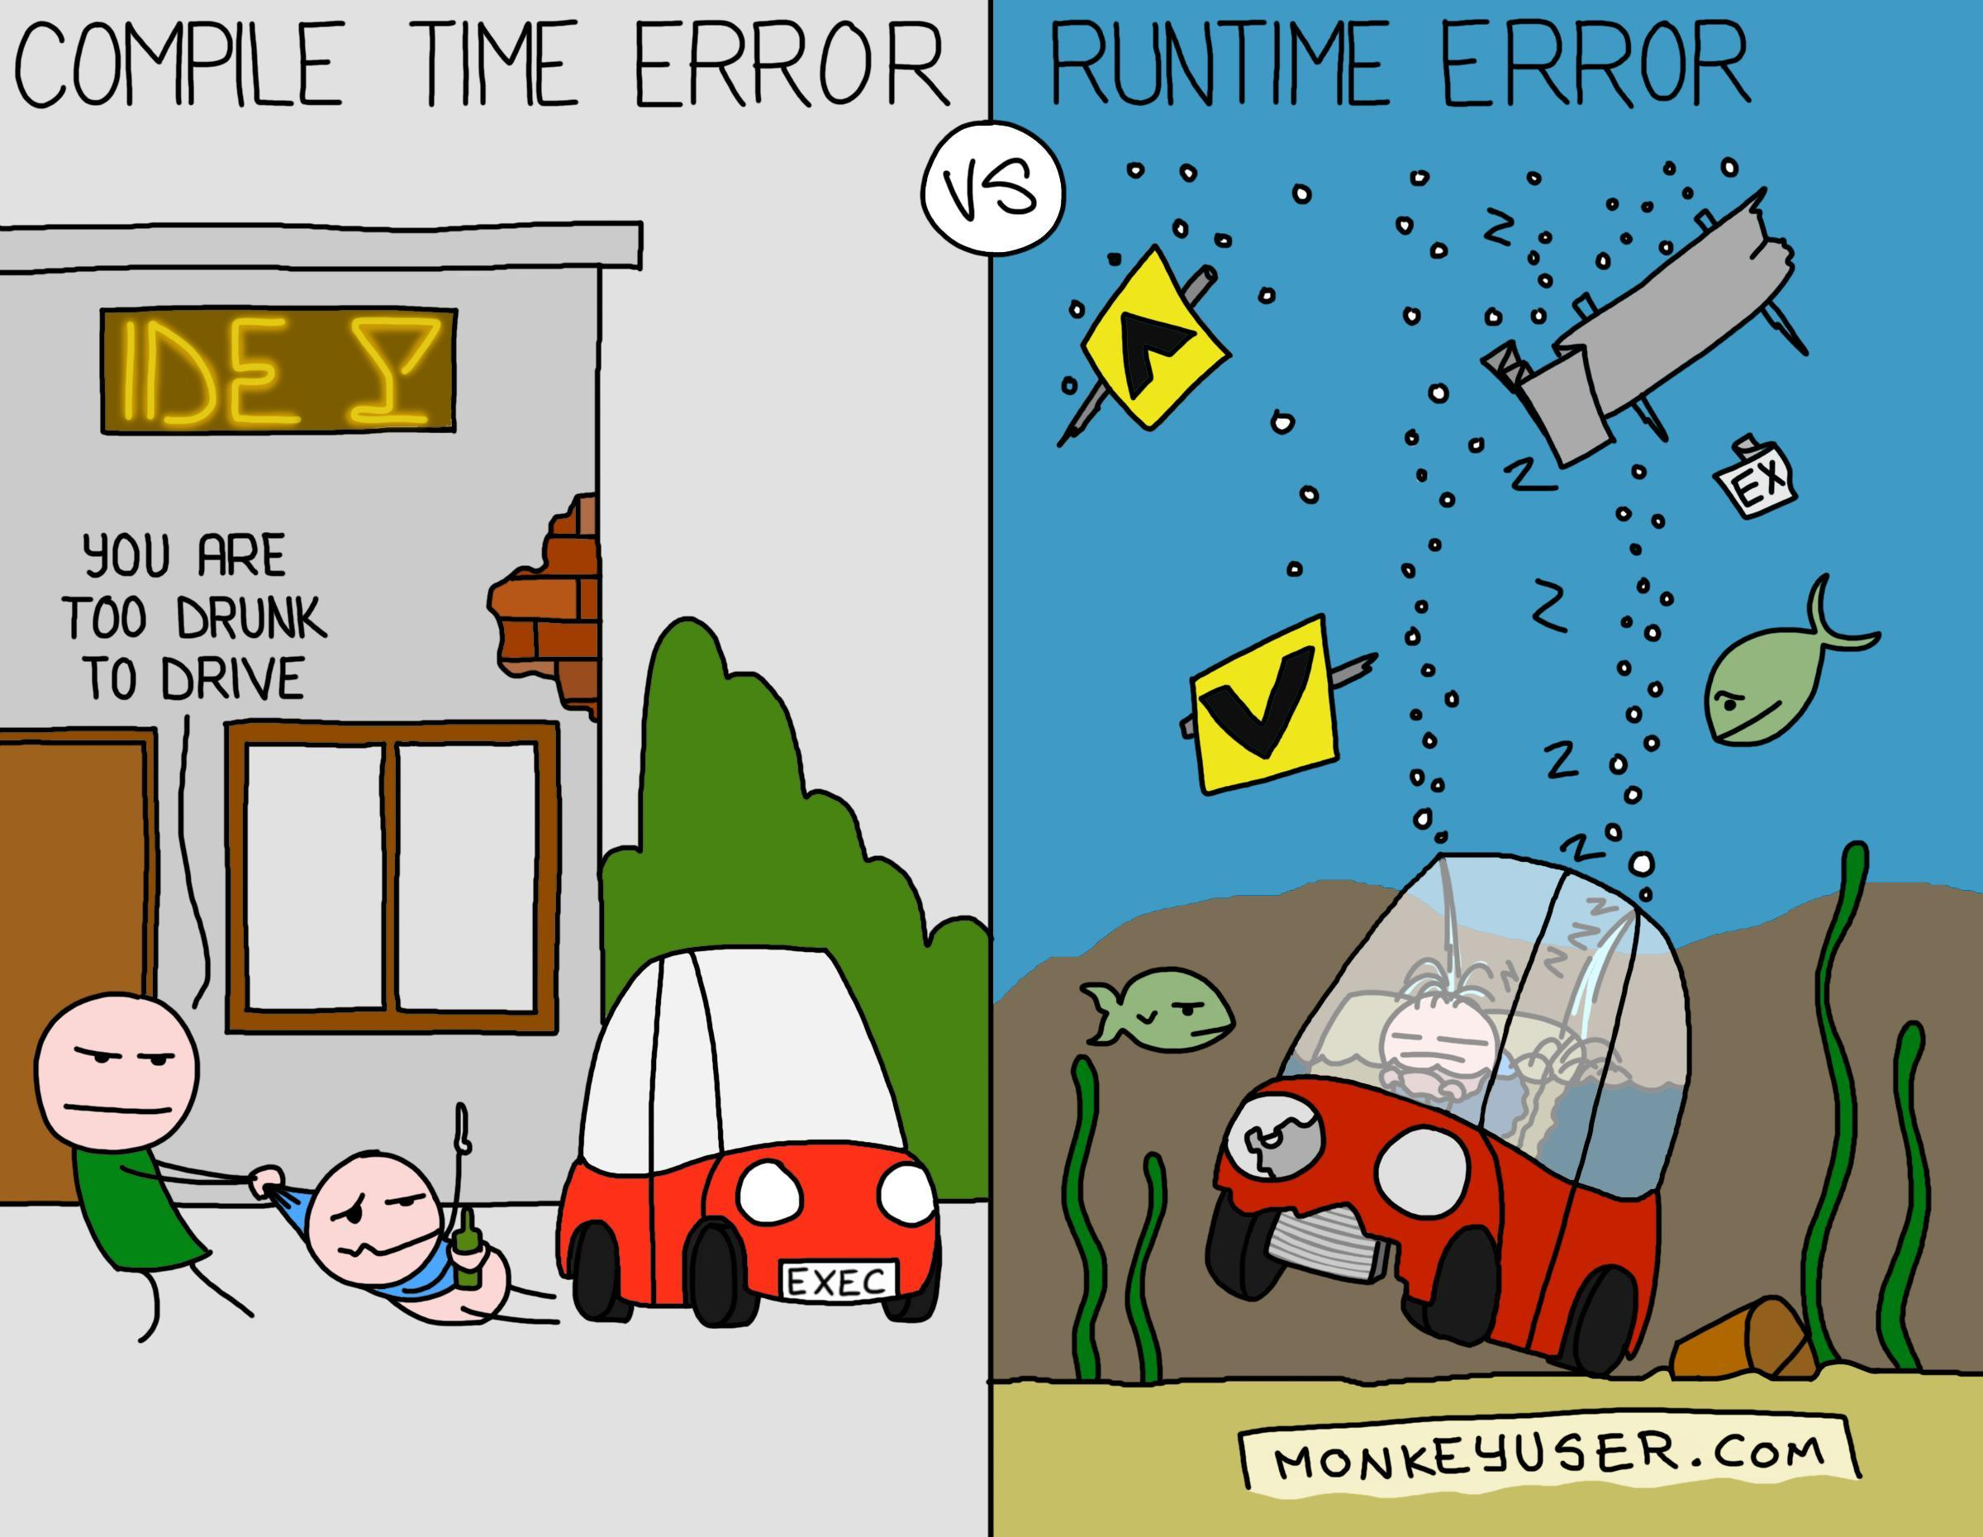
Почему F#?

Slide 11

Почему не F#?

Slide 12
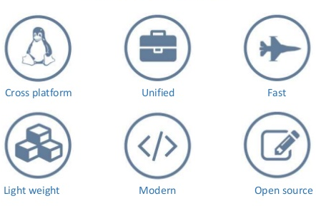
.Net Core

Slide 13
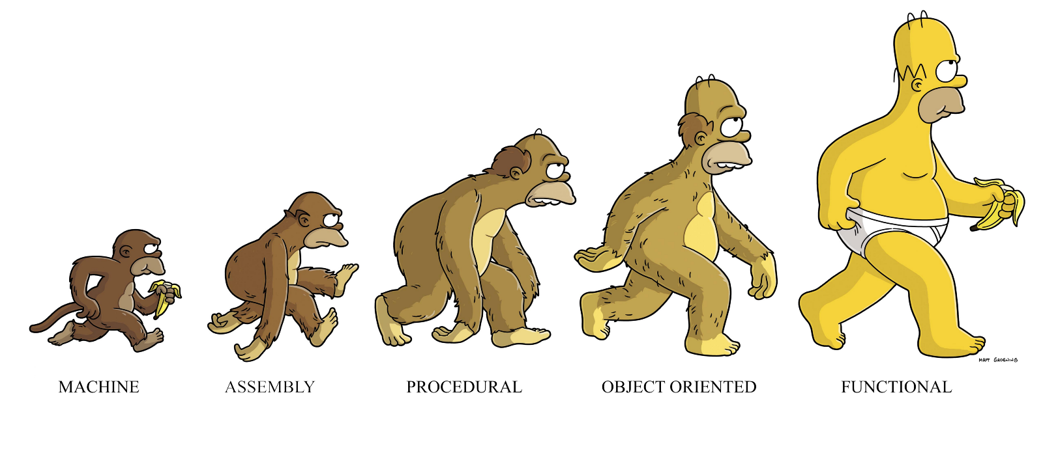
Краткое введение в ФП

Slide 14
Краткое введение в ФП
Функции

Slide 15
Краткое введение в ФП
Функции
let fn a b = 1

Slide 16
Краткое введение в ФП
Функции
let fn a b = 1

Slide 17
Краткое введение в ФП
Функции
let fn a b = 1

Slide 18
Краткое введение в ФП
Функции
let fn a b = 1

Slide 19
Краткое введение в ФП
Функции
let fn a b = 1

Slide 20
Краткое введение в ФП
Функции
Значения

Slide 21
Краткое введение в ФП
Функции
Значения
let PI = 3.1415…

Slide 22
Краткое введение в ФП
Функции
Значения
Выражения

Slide 23
Краткое введение в ФП
Функции
Значения
Выражения
a + b

Slide 24

Telegram Bots

Slide 25
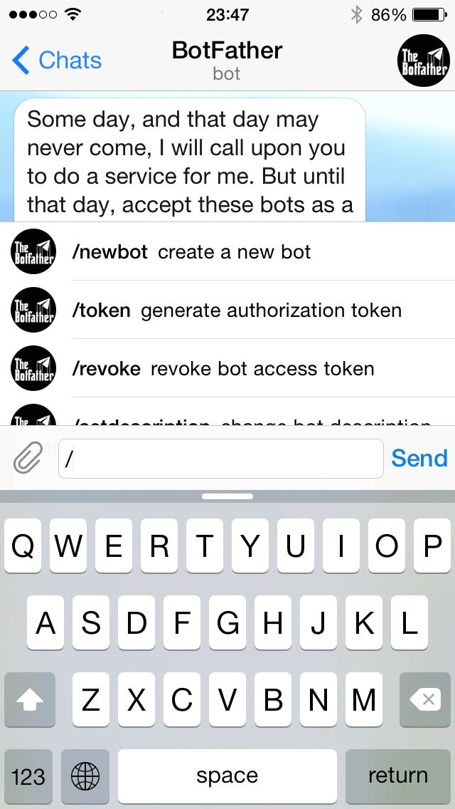
Telegram Bots

Slide 26
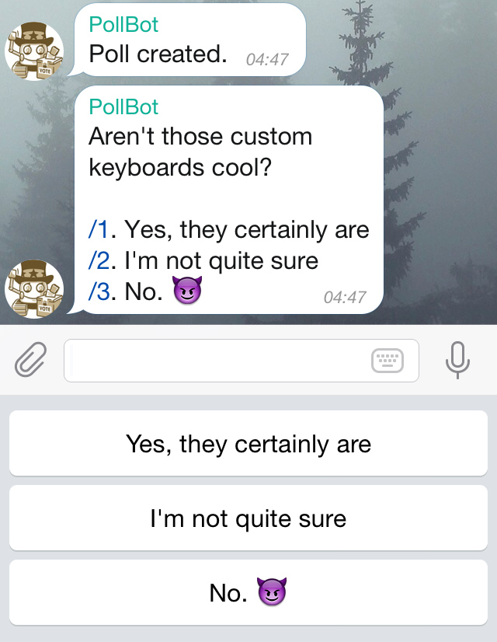
Telegram Bots

Slide 27
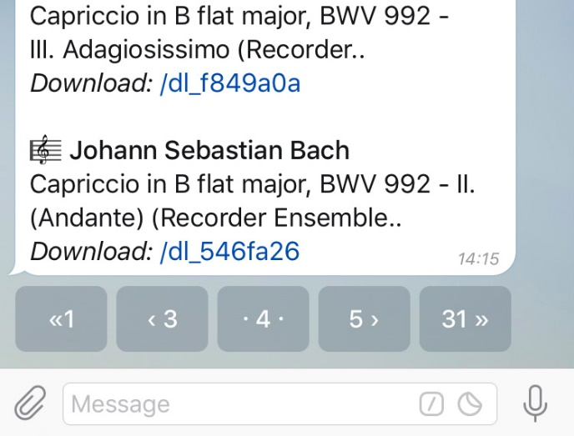
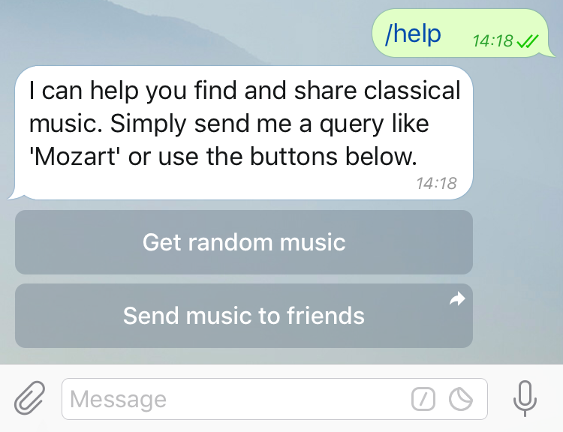

Telegram Bots

Slide 28
Telegram Bot API
Server
Bot App

Slide 29
Telegram Bot API
Server
Server
GET/POST Request
Bot App
Telegram

Slide 30
Telegram Bot API
Server
Server
GET/POST Request
Bot App
Telegram
User

Slide 31
Telegram Bot API
Server
Server
GET/POST Request
Bot App
Telegram
Response
User

Slide 32
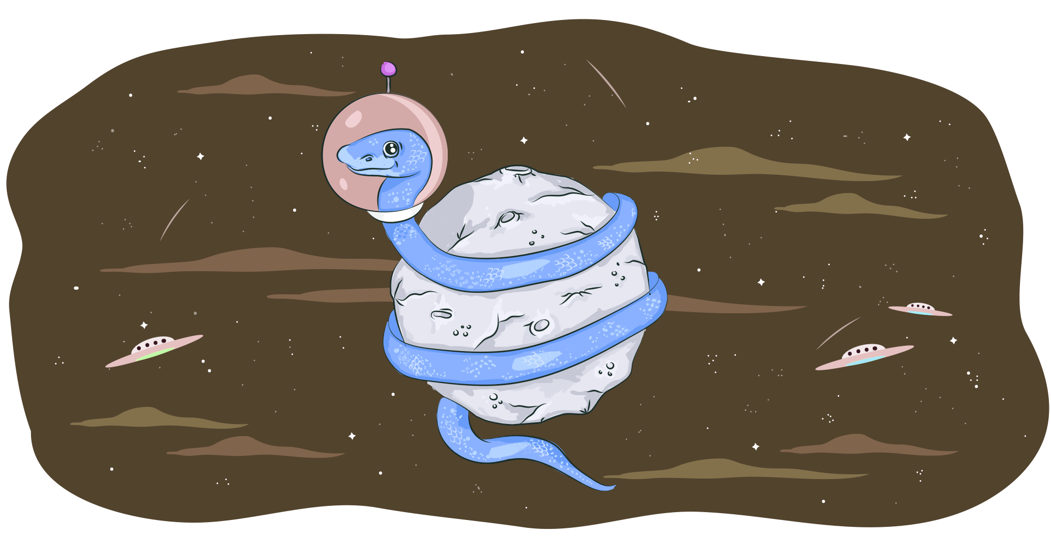

Обёртка над API

Slide 33

.Net обёртка
(Telegram.Bot )

Slide 34

Funogram

Slide 35

Функциональность

Slide 36
Функциональность
sendMessage chatId "Hello, world"
|> api config
|> processResponse

Slide 37
Функциональность
sendMessage chatId "Hello, world"
|> api config
|> processResponse

Slide 38
Функциональность
sendMessage chatId "Hello, world"
|> api config
|> processResponse

Slide 39
Функциональность
sendMessage chatId "Hello, world"
|> api config
|> processResponse

Slide 40
Функциональность
sendMessage chatId "Hello, world"
|> api config
|> processResponse

Slide 41
Функциональность
sendMessage chatId "Hello, world"
|> api config
|> processResponse

Slide 42
Pipe оператор
let (|>) f x = x f

Slide 43
Pipe оператор
let add x y = x + y
add 1 2 |> printf "%i"

Slide 44
Pipe оператор
let add x y = x + y
add 1 2 |> printf "%i"

Slide 45
Pipe оператор
let add x y = x + y
add 1 2 |> printf "%i"

Slide 46
Pipe оператор
let add x y = x + y
add 1 2 |> printf "%i"

Slide 47
Pipe оператор
printf "%i" 3

Slide 48
Pipe оператор
let add x y = x + y
add 1 2 |> printf "%i"
{
{

Slide 49
Pipe оператор
let add x y = x + y
printf "%i" (add 1 2)

Slide 50
Функциональность
sendMessage chatId "Hello, world"
|> api config
|> processResponse

Slide 51

Функциональность
sendMessage chatId "Hello, world"
|> api config
|> processResponse
sendMessage

Slide 52
Функциональность
sendMessage chatId "Hello, world"
|> api config
|> processResponse
sendMessage
api

Slide 53
Функциональность
sendMessage chatId "Hello, world"
|> api config
|> processResponse
sendMessage
api
process

Slide 54
Функциональность
let greater x y = y > x
let less x y = y < x
let numbers = [ 5; 5; 1; 9; 14; 3; 8; 1; 0 ]
let filtered =
numbers
|> Seq.where (greater 0)
|> Seq.where (less 11)
|> Seq.sort

Slide 55
Функциональность
let greater x y = y > x
let less x y = y < x
let numbers = [ 5; 5; 1; 9; 14; 3; 8; 1; 0 ]
let filtered =
numbers
|> Seq.where (greater 0)
|> Seq.where (less 11)
|> Seq.sort

Slide 56
Функциональность
let greater x y = y > x
let less x y = y < x
let numbers = [ 5; 5; 1; 9; 14; 3; 8; 1; 0 ]
let filtered =
numbers
|> Seq.where (greater 0)
|> Seq.where (less 11)
|> Seq.sort

Slide 57
Функциональность
let greater x y = y > x
let less x y = y < x
let numbers = [ 5; 5; 1; 9; 14; 3; 8; 1; 0 ]
let filtered =
numbers
|> Seq.where (greater 0)
|> Seq.where (less 11)
|> Seq.sort

Slide 58
Функциональность
let greater x y = y > x
let less x y = y < x
let numbers = [ 5; 5; 1; 9; 14; 3; 8; 1; 0 ]
let filtered =
numbers
|> Seq.where (greater 0)
|> Seq.where (less 11)
|> Seq.sort

Slide 59
Функциональность
let greater x y = y > x
let less x y = y < x
let numbers = [ 5; 5; 1; 9; 14; 3; 8; 1; 0 ]
let filtered =
numbers
|> Seq.where (greater 0)
|> Seq.where (less 11)
|> Seq.sort

Slide 60
Функциональность
let greater x y = y > x
let less x y = y < x
let numbers = [ 5; 5; 1; 9; 14; 3; 8; 1; 0 ]
let filtered =
numbers
|> Seq.where (greater 0)
|> Seq.where (less 11)
|> Seq.sort

Slide 61
Функциональность
let greater x y = y > x
let less x y = y < x
let numbers = [ 5; 5; 1; 9; 14; 3; 8; 1; 0 ]
let filtered =
numbers
|> Seq.where (greater 0)
|> Seq.where (less 11)
|> Seq.sort

Slide 62
Функциональность
let greater x y = y > x
let less x y = y < x
let numbers = [ 5; 5; 1; 9; 14; 3; 8; 1; 0 ]
let filtered =
numbers
|> Seq.where (greater 0)
|> Seq.where (less 11)
|> Seq.sort

Slide 63
Функциональность
let greater x y = y > x
let less x y = y < x
let numbers = [ 5; 5; 1; 9; 14; 3; 8; 1; 0 ]
let filtered =
numbers
|> Seq.where (greater 0)
|> Seq.where (less 11)
|> Seq.sort
let filtered = [ 1; 1; 3; 5; 5; 8; 9 ]

Slide 64

Иммутабельность

Slide 65
Иммутабельность
Поток 1

Slide 66
Иммутабельность
Поток 1
Поток 2

Slide 67
Иммутабельность
Поток 1
Поток 2
logUpdate
processUpdate

Slide 68
Иммутабельность
Поток 1
Поток 2
logUpdate
processUpdate
Объект update

Slide 69
Иммутабельность
Поток 1
Поток 2
logUpdate
processUpdate
Объект update

Slide 70

Иммутабельность
Поток 1
Поток 2
logUpdate
processUpdate
Объект update

Slide 71

Иммутабельность
Поток 1
Поток 2
logUpdate
processUpdate
Объект update

Slide 72
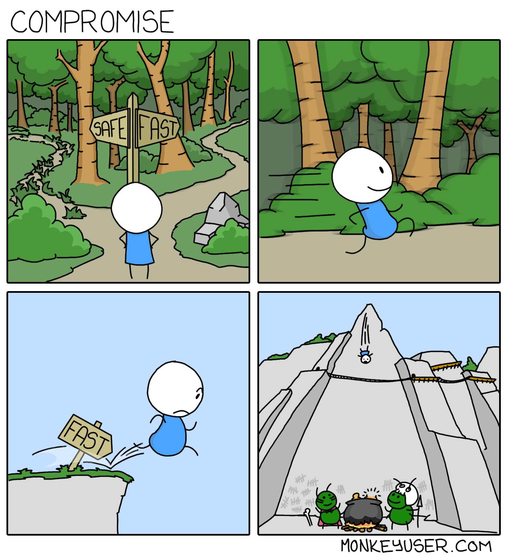

Slide 73
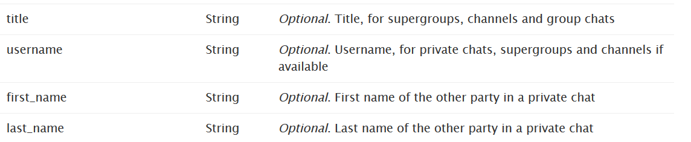
Null Safe

Slide 74
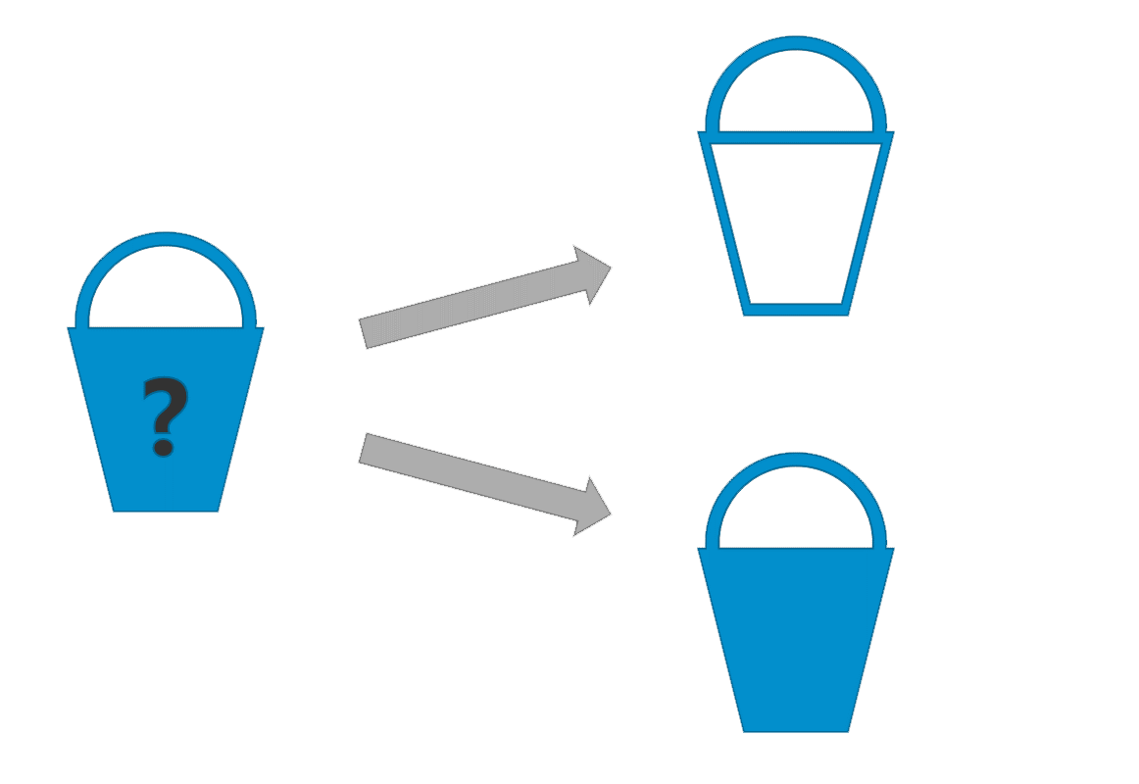
Тип Option
Option

Slide 75
Тип Option
None
Option

Slide 76
Тип Option
None
Option
Some

Slide 77
Тип Option
let message = context.Update.Message
match message with
| Some msg -> processMessage msg
| None -> printf "Update has no message."

Slide 78
Тип Option
let message = context.Update.Message
match message with
| Some msg -> processMessage msg
| None -> printf "Update has no message."

Slide 79
Pattern Matching
match expression with

Slide 80
Pattern Matching
match expression with
| pattern

Slide 81
Pattern Matching
match expression with
| pattern -> result-expression

Slide 82
Pattern Matching
let rec factorial n =
match n with
| 0 | 1 -> 1
| _ -> n * factorial(n - 1)

Slide 83
Pattern Matching
let rec factorial n =
match n with
| 0 | 1 -> 1
| _ -> n * factorial(n - 1)

Slide 84
Pattern Matching
let rec factorial n =
match n with
| 0 | 1 -> 1
| _ -> n * factorial(n - 1)

Slide 85
Pattern Matching
let rec factorial n =
match n with
| 0 | 1 -> 1
| _ -> n * factorial(n - 1)

Slide 86
Pattern Matching
match someValue with
| :? string -> "someValue is string"
| :? int -> "someValue is integer"
| _ -> "What is it?"

Slide 87
Pattern Matching
match someValue with
| :? string -> "someValue is string"
| :? int -> "someValue is integer"
| _ -> "What is it?"

Slide 88
Pattern Matching
match someValue with
| :? string -> "someValue is string"
| :? int -> "someValue is integer"
| _ -> "What is it?"

Slide 89
Pattern Matching
match someValue with
| :? string -> "someValue is string"
| :? int -> "someValue is integer"
| _ -> "What is it?"

Slide 90
Тип Option
let message = context.Update.Message
match message with
| Some msg -> processMessage msg
| None -> printf "Update has no message."

Slide 91
Тип Option
let message = context.Update.Message
match message with
| Some msg -> processMessage msg
| None -> printf "Update has no message."

Slide 92
Тип Option
let message = context.Update.Message
match message with
| Some msg -> processMessage msg
| None -> printf "Update has no message."

Slide 93
Тип Option
let message = context.Update.Message
match message with
| Some msg -> processMessage msg
| None -> printf "Update has no message."

Slide 94
Тип Option
let message = context.Update.Message
match message with
| Some msg -> processMessage msg
| None -> printf "Update has no message."

Slide 95
Тип Option
let message = context.Update.Message
match message with
| Some msg -> processMessage msg
| None -> printf "Update has no message."

Slide 96
Тип Option
let message = context.Update.Message
processMessage message

Slide 97
Тип Option
maybe { let! message = context.Update.Message
processMessage message
}

Slide 98
Тип Option
maybe { let! message = context.Update.Message
processMessage message
}

Slide 99
Тип Option
maybe { let! message = context.Update.Message
processMessage message
}

Slide 100
Тип Option
maybe { let! message = context.Update.Message
processMessage message
}

Slide 101
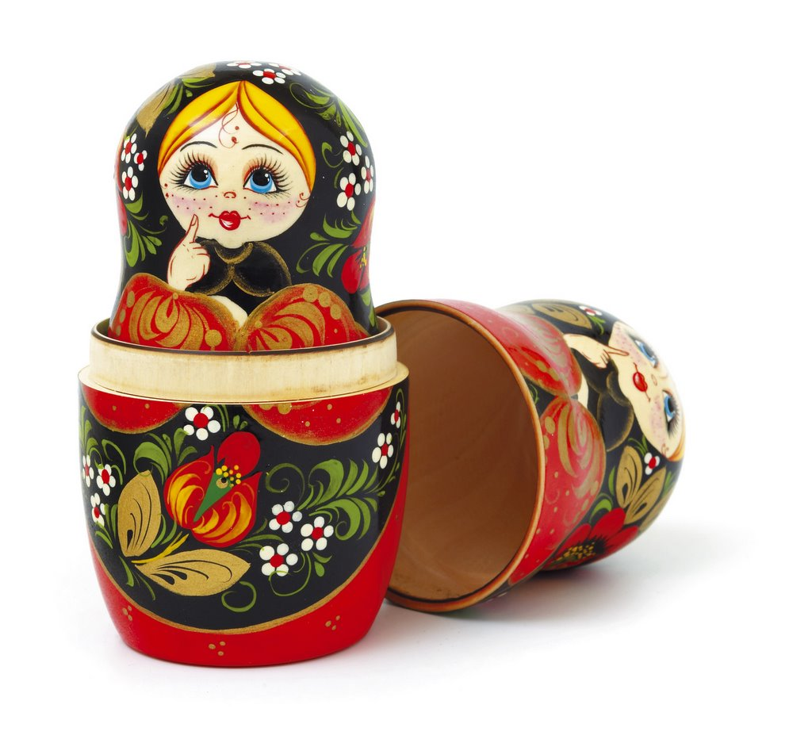
Обёртка над обёрткой

Slide 102
Обёртка над обёрткой
startBot {
defaultConfig with Token = "BOT_TOKEN"
} update None

Slide 103
Обёртка над обёрткой
startBot {
defaultConfig with Token = "BOT_TOKEN"
} update None

Slide 104
Обёртка над обёрткой
startBot {
defaultConfig with Token = "BOT_TOKEN"
} update None

Slide 105
Обёртка над обёрткой
let update context =
processCommands context [
cmd "/meow" onMeow
] |> ignore

Slide 106
Обёртка над обёрткой
let update context =
processCommands context [
cmd "/meow" onMeow
] |> ignore

Slide 107
Обёртка над обёрткой
let update context =
processCommands context [
cmd "/meow" onMeow
] |> ignore

Slide 108
Обёртка над обёрткой
let update context =
processCommands context [
cmd "/meow" onMeow
] |> ignore

Slide 109
Обёртка над обёрткой
let update context =
processCommands context [
cmd "/meow" onMeow
] |> ignore

Slide 110
Обёртка над обёрткой
let update context =
processCommands context [
cmd "/meow" onMeow
] |> ignore

Slide 111
Обёртка над обёрткой
let update context =
processCommands context [
cmdScan "/meow %s" onMeow
] |> ignore

Slide 112

Мяу бот
@MeowCatsBot

Slide 113


Slide 114
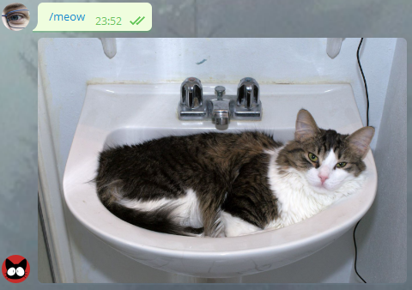

Slide 115


Slide 116
Мяу бот
let onMeow context =
maybe {
let! message = context.Update.Message
let json = ApiUrl |> CatsApi.Load
let file = Uri json.File |> FileToSend.Url
sendPhoto message.Chat.Id file "" |> execute
} |> ignore

Slide 117
Мяу бот
let onMeow context =
maybe {
let! message = context.Update.Message
let json = ApiUrl |> CatsApi.Load
let file = Uri json.File |> FileToSend.Url
sendPhoto message.Chat.Id file "" |> execute
} |> ignore

Slide 118
Мяу бот
let onMeow context =
maybe {
let! message = context.Update.Message
let json = ApiUrl |> CatsApi.Load
let file = Uri json.File |> FileToSend.Url
sendPhoto message.Chat.Id file "" |> execute
} |> ignore

Slide 119
Мяу бот
let onMeow context =
maybe {
let! message = context.Update.Message
let json = ApiUrl |> CatsApi.Load
let file = Uri json.File |> FileToSend.Url
sendPhoto message.Chat.Id file "" |> execute
} |> ignore

Slide 120
Мяу бот
let onMeow context =
maybe {
let! message = context.Update.Message
let json = ApiUrl |> CatsApi.Load
let file = Uri json.File |> FileToSend.Url
sendPhoto message.Chat.Id file "" |> execute
} |> ignore

Slide 121
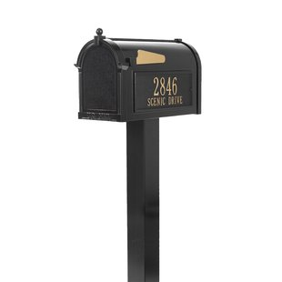
Mailbox

Slide 122
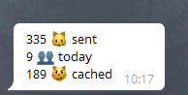
Mailbox

Slide 123
let statsAgent = MailboxProcessor.Start(fun inbox ->
let rec messageLoop state = async {
let! message = inbox.Receive()
return! messageLoop <|
match message with
| StatsMessage.StateCommand context ->
sendState context state
| StatsMessage.UpdateTotalPicsSent totalCats ->
{ state with TotalPicsSent = totalCats }
| StatsMessage.UpdateTotalUsers totalUsers ->
{ state with TotalUsersToday = totalUsers }
| StatsMessage.UpdateTotalCached totalCached ->
{ state with TotalCached = totalCached }
}
messageLoop {
TotalPicsSent = 0
TotalUsersToday = 0
TotalCached = 0
})

Slide 124
let statsAgent = MailboxProcessor.Start(fun inbox ->
let rec messageLoop state = async {
let! message = inbox.Receive()
return! messageLoop <|
match message with
| StatsMessage.StateCommand context ->
sendState context state
| StatsMessage.UpdateTotalPicsSent totalCats ->
{ state with TotalPicsSent = totalCats }
| StatsMessage.UpdateTotalUsers totalUsers ->
{ state with TotalUsersToday = totalUsers }
| StatsMessage.UpdateTotalCached totalCached ->
{ state with TotalCached = totalCached }
}
messageLoop {
TotalPicsSent = 0
TotalUsersToday = 0
TotalCached = 0
})

Slide 125
let statsAgent = MailboxProcessor.Start(fun inbox ->
let rec messageLoop state = async {
let! message = inbox.Receive()
return! messageLoop <|
match message with
| StatsMessage.StateCommand context ->
sendState context state
| StatsMessage.UpdateTotalPicsSent totalCats ->
{ state with TotalPicsSent = totalCats }
| StatsMessage.UpdateTotalUsers totalUsers ->
{ state with TotalUsersToday = totalUsers }
| StatsMessage.UpdateTotalCached totalCached ->
{ state with TotalCached = totalCached }
}
messageLoop {
TotalPicsSent = 0
TotalUsersToday = 0
TotalCached = 0
})

Slide 126
let statsAgent = MailboxProcessor.Start(fun inbox ->
let rec messageLoop state = async {
let! message = inbox.Receive()
return! messageLoop <|
match message with
| StatsMessage.StateCommand context ->
sendState context state
| StatsMessage.UpdateTotalPicsSent totalCats ->
{ state with TotalPicsSent = totalCats }
| StatsMessage.UpdateTotalUsers totalUsers ->
{ state with TotalUsersToday = totalUsers }
| StatsMessage.UpdateTotalCached totalCached ->
{ state with TotalCached = totalCached }
}
messageLoop {
TotalPicsSent = 0
TotalUsersToday = 0
TotalCached = 0
})

Slide 127
let statsAgent = MailboxProcessor.Start(fun inbox ->
let rec messageLoop state = async {
let! message = inbox.Receive()
return! messageLoop <|
match message with
| StatsMessage.StateCommand context ->
sendState context state
| StatsMessage.UpdateTotalPicsSent totalCats ->
{ state with TotalPicsSent = totalCats }
| StatsMessage.UpdateTotalUsers totalUsers ->
{ state with TotalUsersToday = totalUsers }
| StatsMessage.UpdateTotalCached totalCached ->
{ state with TotalCached = totalCached }
}
messageLoop {
TotalPicsSent = 0
TotalUsersToday = 0
TotalCached = 0
})

Slide 128
let statsAgent = MailboxProcessor.Start(fun inbox ->
let rec messageLoop state = async {
let! message = inbox.Receive()
return! messageLoop <|
match message with
| StatsMessage.StateCommand context ->
sendState context state
| StatsMessage.UpdateTotalPicsSent totalCats ->
{ state with TotalPicsSent = totalCats }
| StatsMessage.UpdateTotalUsers totalUsers ->
{ state with TotalUsersToday = totalUsers }
| StatsMessage.UpdateTotalCached totalCached ->
{ state with TotalCached = totalCached }
}
messageLoop {
TotalPicsSent = 0
TotalUsersToday = 0
TotalCached = 0
})

Slide 129
let statsAgent = MailboxProcessor.Start(fun inbox ->
let rec messageLoop state = async {
let! message = inbox.Receive()
return! messageLoop <|
match message with
| StatsMessage.StateCommand context ->
sendState context state
| StatsMessage.UpdateTotalPicsSent totalCats ->
{ state with TotalPicsSent = totalCats }
| StatsMessage.UpdateTotalUsers totalUsers ->
{ state with TotalUsersToday = totalUsers }
| StatsMessage.UpdateTotalCached totalCached ->
{ state with TotalCached = totalCached }
}
messageLoop {
TotalPicsSent = 0
TotalUsersToday = 0
TotalCached = 0
})

Slide 130
let statsAgent = MailboxProcessor.Start(fun inbox ->
let rec messageLoop state = async {
let! message = inbox.Receive()
return! messageLoop <|
match message with
| StatsMessage.StateCommand context ->
sendState context state
| StatsMessage.UpdateTotalPicsSent totalCats ->
{ state with TotalPicsSent = totalCats }
| StatsMessage.UpdateTotalUsers totalUsers ->
{ state with TotalUsersToday = totalUsers }
| StatsMessage.UpdateTotalCached totalCached ->
{ state with TotalCached = totalCached }
}
messageLoop {
TotalPicsSent = 0
TotalUsersToday = 0
TotalCached = 0
})

Slide 131
let statsAgent = MailboxProcessor.Start(fun inbox ->
let rec messageLoop state = async {
let! message = inbox.Receive()
return! messageLoop <|
match message with
| StatsMessage.StateCommand context ->
sendState context state
| StatsMessage.UpdateTotalPicsSent totalCats ->
{ state with TotalPicsSent = totalCats }
| StatsMessage.UpdateTotalUsers totalUsers ->
{ state with TotalUsersToday = totalUsers }
| StatsMessage.UpdateTotalCached totalCached ->
{ state with TotalCached = totalCached }
}
messageLoop {
TotalPicsSent = 0
TotalUsersToday = 0
TotalCached = 0
})

Slide 132
let statsAgent = MailboxProcessor.Start(fun inbox ->
let rec messageLoop state = async {
let! message = inbox.Receive()
return! messageLoop <|
match message with
| StatsMessage.StateCommand context ->
sendState context state
| StatsMessage.UpdateTotalPicsSent totalCats ->
{ state with TotalPicsSent = totalCats }
| StatsMessage.UpdateTotalUsers totalUsers ->
{ state with TotalUsersToday = totalUsers }
| StatsMessage.UpdateTotalCached totalCached ->
{ state with TotalCached = totalCached }
}
messageLoop {
TotalPicsSent = 0
TotalUsersToday = 0
TotalCached = 0
})

Slide 133
let statsAgent = MailboxProcessor.Start(fun inbox ->
let rec messageLoop state = async {
let! message = inbox.Receive()
return! messageLoop <|
match message with
| StatsMessage.StateCommand context ->
sendState context state
| StatsMessage.UpdateTotalPicsSent totalCats ->
{ state with TotalPicsSent = totalCats }
| StatsMessage.UpdateTotalUsers totalUsers ->
{ state with TotalUsersToday = totalUsers }
| StatsMessage.UpdateTotalCached totalCached ->
{ state with TotalCached = totalCached }
}
messageLoop {
TotalPicsSent = 0
TotalUsersToday = 0
TotalCached = 0
})

Slide 134
let statsAgent = MailboxProcessor.Start(fun inbox ->
let rec messageLoop state = async {
let! message = inbox.Receive()
return! messageLoop <|
match message with
| StatsMessage.StateCommand context ->
sendState context state
| StatsMessage.UpdateTotalPicsSent totalCats ->
{ state with TotalPicsSent = totalCats }
| StatsMessage.UpdateTotalUsers totalUsers ->
{ state with TotalUsersToday = totalUsers }
| StatsMessage.UpdateTotalCached totalCached ->
{ state with TotalCached = totalCached }
}
messageLoop {
TotalPicsSent = 0
TotalUsersToday = 0
TotalCached = 0
})

Slide 135
Провайдеры типов
let json = ApiUrl |> CatsApi.Load

Slide 136
Провайдеры типов
{
"file":"cat.jpg"
}

Slide 137
Провайдеры типов
let ApiUrl = "http://aws.random.cat/meow"
type CatsApi = JsonProvider<ApiUrl>

Slide 138
Провайдеры типов
type CatsApi = { File: string }

Slide 139
Провайдеры типов
type sql = SqlDataProvider<
Common.DatabaseProviderTypes.SQLITE,
connectionString,
ResolutionPath = resolutionPath,
CaseSensitivityChange = Common.CaseSensitivityChange.ORIGINAL>
let ctx = sql.GetDataContext()

Slide 140
Провайдеры типов
let example =
query {
for order in ctx.Main.Orders do
where (order.Freight > 0m)
sortBy (order.ShipPostalCode)
skip 3
take 4
select (order)
}

Slide 141

Провайдеры типов

Slide 142
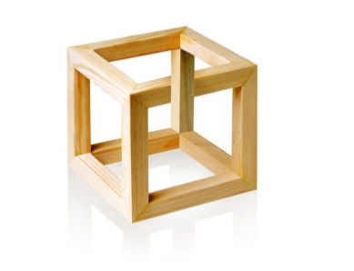
Вывод типов

Slide 143
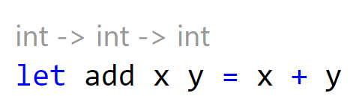
Вывод типов

Slide 144
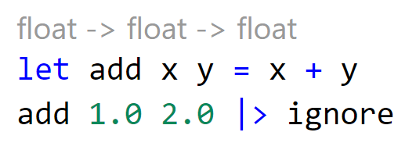
Вывод типов

Slide 145
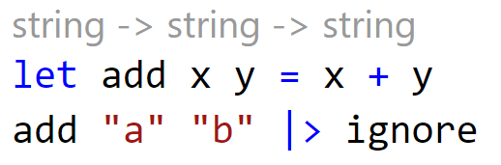
Вывод типов

Slide 146
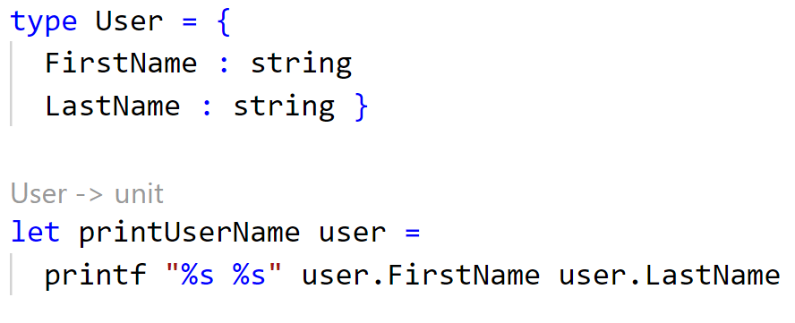
Вывод типов

Slide 147
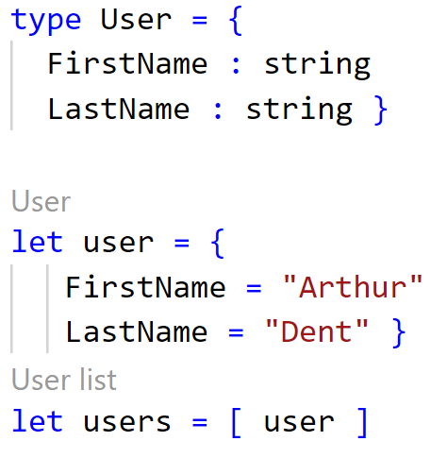
Вывод типов

Slide 148

Fable

Slide 149

Akka.Net

Slide 150
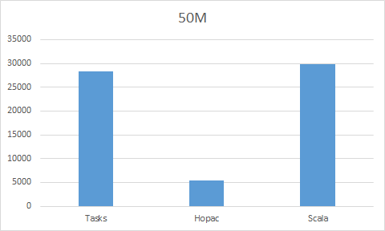
Hopac

Slide 151

@fsharp_chat
https://github.com/Dolfik1/Presentations

